Slide 1
Price Manipulation
*Name: Ali Hussein Issa
*Web App-Development

Slide 2

-Introduction ……………………………………………………………………………………………………………………
-Problem…………………………………………………………………………………………………………………………..
-Solution…………………………………………………………………………………………………………………………..
-Phase-1-:HTML-CSS………………………………………………………………………………………………………….
-Phase-2-:JavaScript…………………………………………………………………………………………………………..
-Phase-3-:PHP……………………………………………………………………………………………………………………
-Future Plan: ……………………………………………………………………………………………………………………
-Conclusion:………………………………………………………………………………………………………………………

Slide 3
Introduction:
Following the first large demonstration of the 17 October 2019 protest . The exchange rate of the US dollar on the black market continues to fluctuate greatly due to the depreciation of the Lebanese lira due to the severe shortage of the US dollar inside Lebanon.

Slide 4
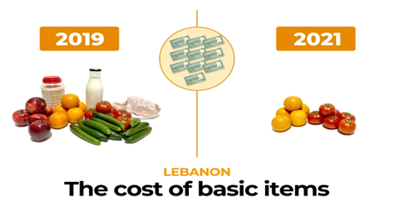
Problem:
The Instability in the price of the dollar .
People are facing nowadays a big problem in finding a market with good prices.
Governments are not knowing what happen.
Markets are putting their prices and what products and goods they have.

Slide 5
Solution:
“Price Manipulation” will make it easier on costumers to :
→Find markets near them with good prices
→Can help them compare it with the governmental price list of all goods.
→It helps customers to report any market that is manipulating prices and goods
→Government will always be up to date on all the markets prices and people’s reports and will take action against any market that is not following their conditions.
→It helps markets to keep up with the government and to be updated to the Ministry of economy and trades.

Slide 6
Phase-1-:HTML-CSS
SIGNIN/SIGNUP
Main Page
Market page
Report page
Best supermarkets
Feedback
Create account for market
Pricelist
Reported markets

Slide 7
How I use HTML & CSS?
HTML | CSS
Insert Images List markets Table for Employee Implement Header and Footer Insert buttons for navigating from page to other Insert icons Structure pages with Grid Forms to enter Data Map of Markets(google maps) | Change colors, background, font ,size, weight for tables ,texts and div Make the website Responsive Position of the Elements
 | WEEK 1 | WEEK 2 | WEEK 3 | WEEK 4 | WEEK 5 | WEEK 6 | WEEK 7 | WEEK 8 | WEEK 9 | WEEK 10 | WEEK 11 | WEEK 12 | WEEK 13 | WEEK 14 | WEEK 15
Phase-1

Slide 8
Phase-2-:JavaScript:
Button work
Functions
Filter Search input
Password validation
Menu Bar
Rating markets
Add/Delete products
Display model
Animate Arrow for SignIn
While Hover at news display date of publication
*Where I use JS:

Slide 9
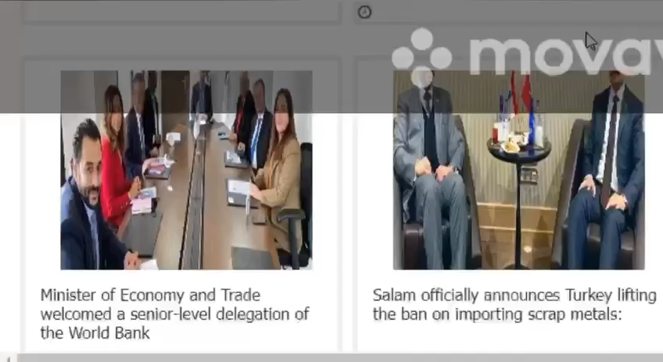
 | WEEK 1 | WEEK 2 | WEEK 3 | WEEK 4 | WEEK 5 | WEEK 6 | WEEK 7 | WEEK 8 | WEEK 9 | WEEK 10 | WEEK 11 | WEEK 12 | WEEK 13 | WEEK 14 | WEEK 15
Phase-1
Phase-2

Slide 10
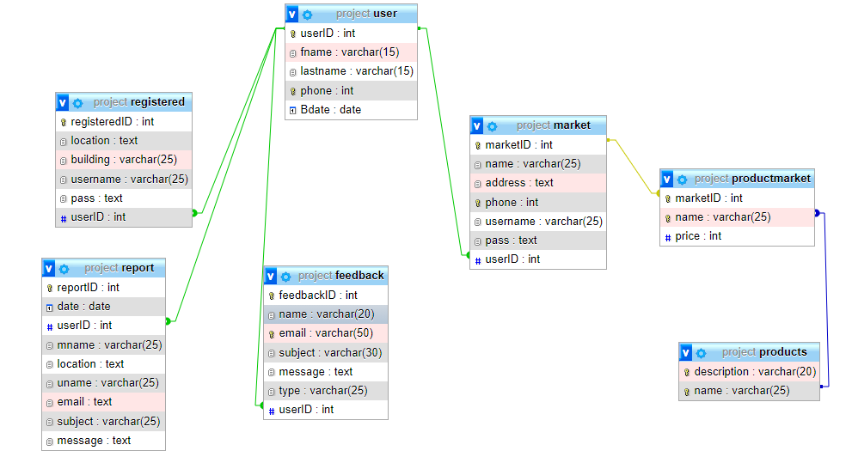
Phase-3-:PHP:
*Create tables:

Slide 11
*Where I use PHP?
User
Create acc
Login verification
Load Reported Markets
Add Reports
Load markets and its goods
Add Feedback

Slide 12
*Where I use PHP?
Market
Create acc
Login verification
Load pricelist
Report a Problem
Add products
Delete products
Add Price for products
 | WEEK 1 | WEEK 2 | WEEK 3 | WEEK 4 | WEEK 5 | WEEK 6 | WEEK 7 | WEEK 8 | WEEK 9 | WEEK 10 | WEEK 11 | WEEK 12 | WEEK 13 | WEEK 14 | WEEK 15
Phase-1
Phase-2
Phase-3

Slide 13
Future Plan:
improve this project by adding more solutions for this problem
Introduce it to the costumers to see how are the opinions about it
Introduce it to markets
Have the approval of a good number of markets to be a part of this project
Introduce it to the government

Slide 14
Conclusion:
Price Manipulation Is the best idea to help Lebanese people in getting a better life by helping, both customers and markets in many different ways to make it easier to find good prices and follow the latest news, not forgetting to report all the markets that are not committed to the prices listed by the government.

